Slide 1
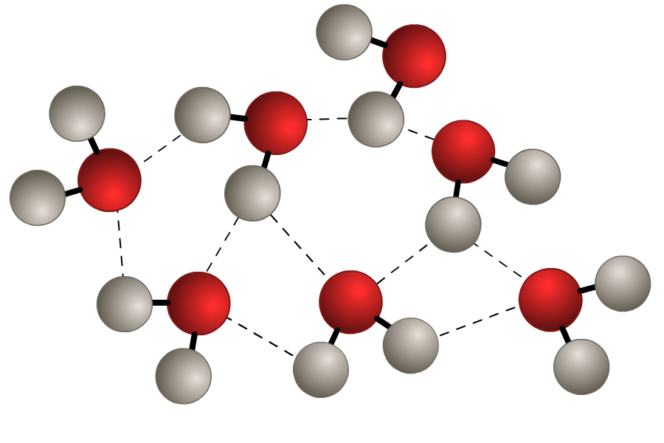
Molecular Structures
Unit 2
Lesson 6

Slide 2
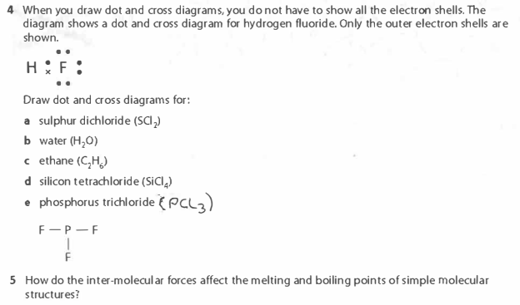
Starter: questions on page 34

Slide 3
Today’s Aim
Unit 6
Lesson 2
By the end of this lesson I will be able to state and explain the properties of molecular substances.

Slide 4
Molecular structures
strong covalent bonds within molecules
weak intermolecular forces between different molecules
The weak forces of attraction between molecules results in low melting and boiling points and so most simple molecular substances are gas at room temperature. (NB: water is a liquid and there are a few solids).

Slide 5
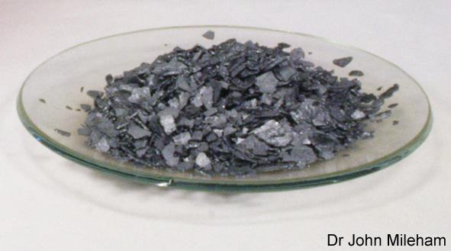
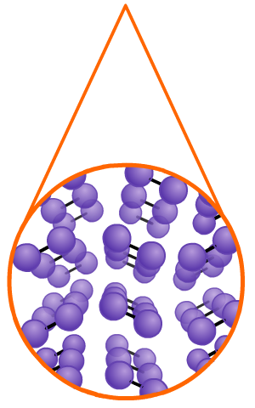
There are some molecular solids
A few substances made up of simple covalent molecules are solid at room temperature. These are molecular solids.
Iodine is a molecular solid at room temperature. Two iodine atoms form a single covalent bond to become an iodine molecule.
The solid is formed because millions of iodine molecules are held together by weak forces of attraction to create a 3D molecular lattice.
weak forces of attraction

Slide 6
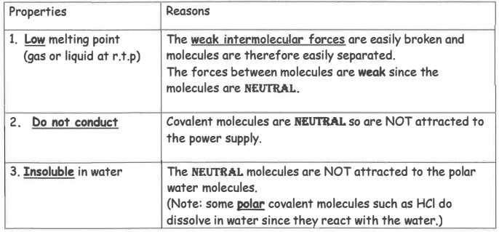
Summary of molecular substances - page 32
Some are soluble, others are not

Slide 7
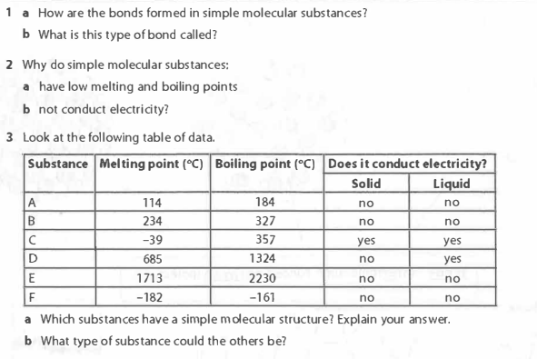
Questions on page 33
The covalent bonds within a molecule consist of the electrostatic attraction between the nuclei of different atoms and the shared pair of electrons.
There are weak intermolecular forces between the different molecules
There are no charged particles to flow. (i.e. no free electrons and no ions)
A, B and F
They have low b.p and do not conduct
C - metal, D - ionic, E - giant covalent

Slide 8
Question 5 on page 34
As intermolecular forces are weak, little energy is needed to overcome them. Therefore, molecular structures tend to have low melting and boiling points.

Slide 9
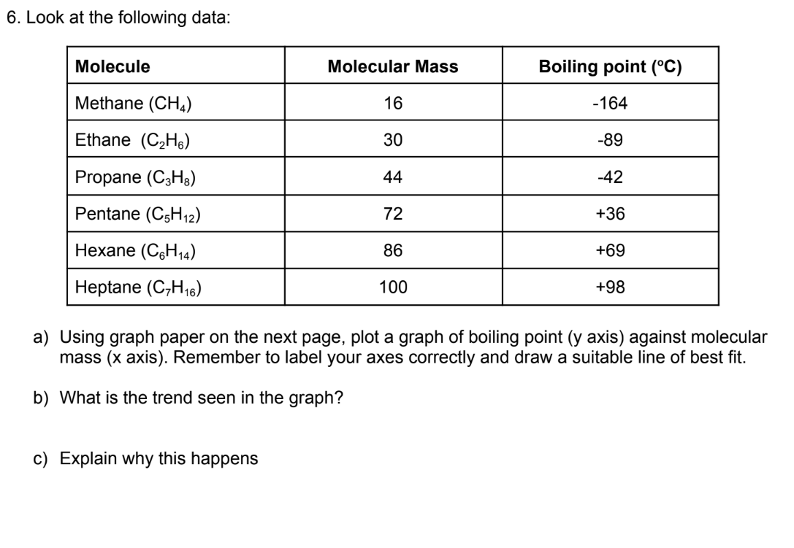
Question 6 on page 34
As the molecular mass increases, the boiling point also increases
An increasing molecular mass causes stronger intermolecular forces. Stronger forces results in higher boiling points.

Slide 10

Graph on page 35

Slide 11

What you need to know
Unit 6
Lesson 2
Syllabus Content
1.47
explain why substances with a simple molecular structures are gases or liquids, or solids with low melting and boiling points (the term “weak intermolecular forces of attraction” should be used to represent all forces between molecules).
1.48
explain why the melting and boiling points of substances with simple molecular structures increase, in general, with increasing relative molecular mass.
My Learning

